Slide 1

Aerothermochemistry and Combustion
Saleem Raza
Jeonbuk National University Department Of Mechanical Design Engineering

Slide 2
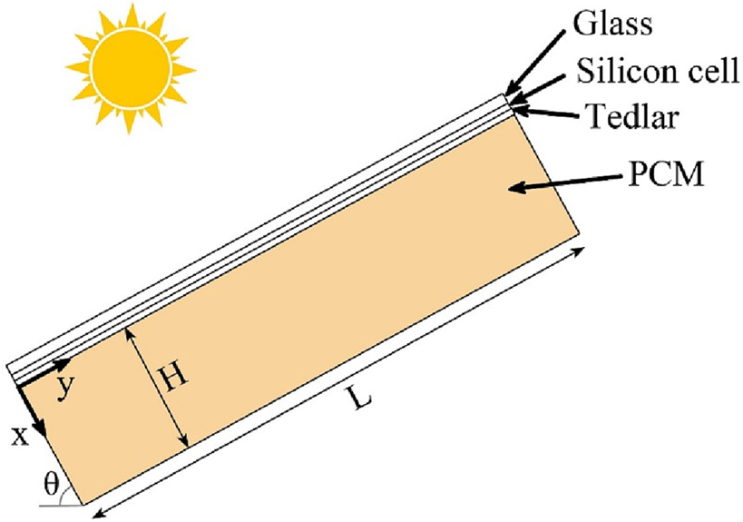
Methodology
Silicon layer is an opaque and absorbent material
A part of heat gained by the glass cover dissipates by convection to the ambient and radiation to the sky
The remaining energy is stored in the glass cover
2

Slide 3

Methodology
For modeling melting process of phase change enthalpy-porosity technique is used
Mushy zone is modeled as a pseudo porous medium
The PCM density is modeled by Boussinesq approximation

Slide 4
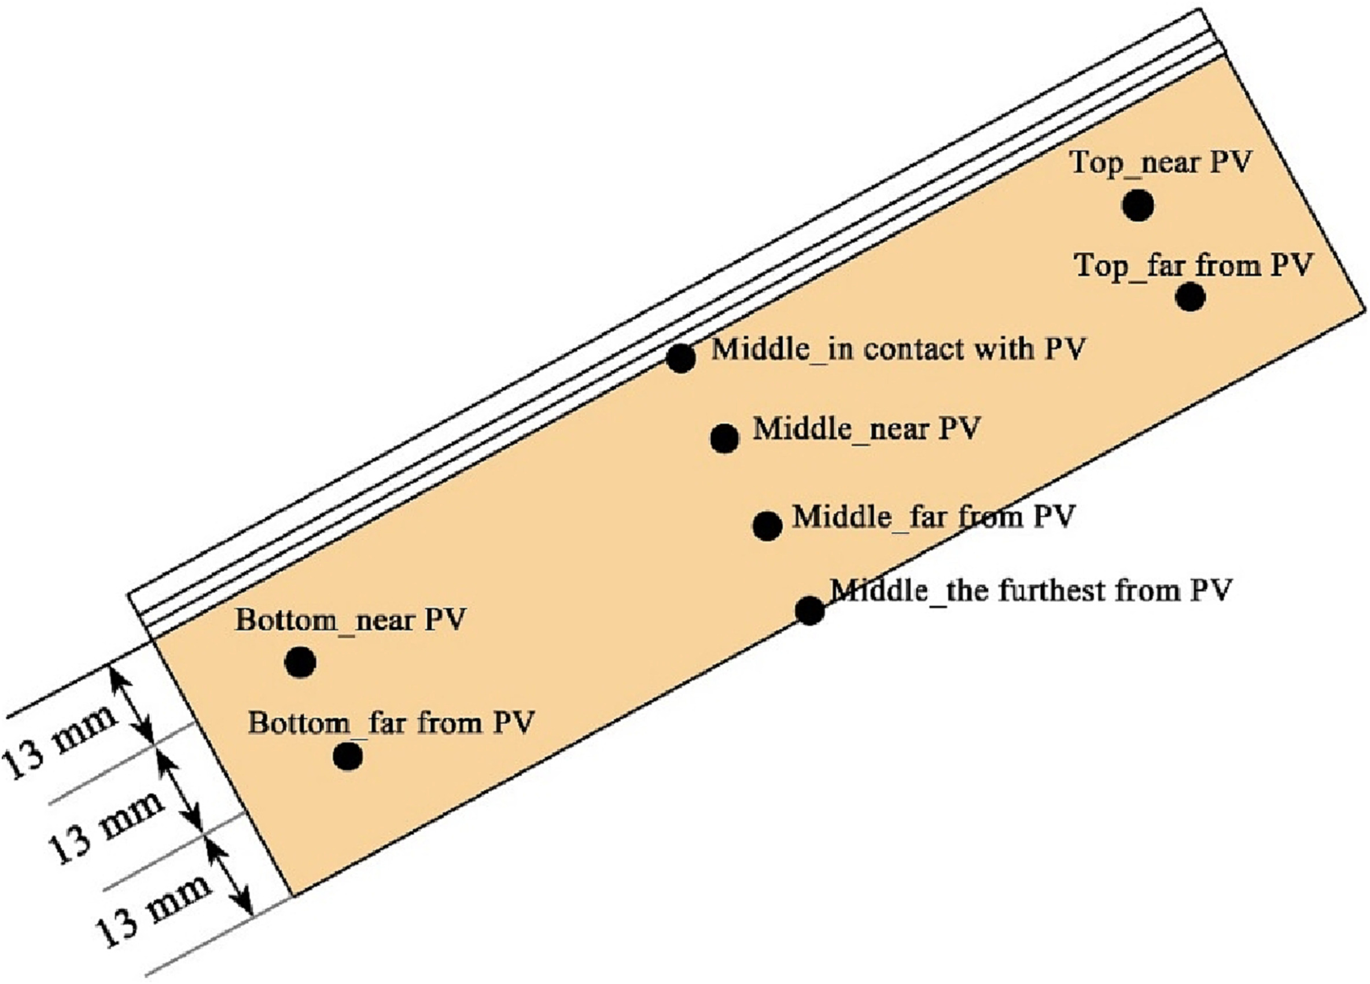
Numerical Procedure
Two axis sun tracker is used for the PV-PCM system in this model, the PV panel is perpendicular to the direction of the solar radiation at all times and heat flux has small variation
The PCM temperatures are calculated for a few specific points at Top, middle and bottom of the container

Slide 5
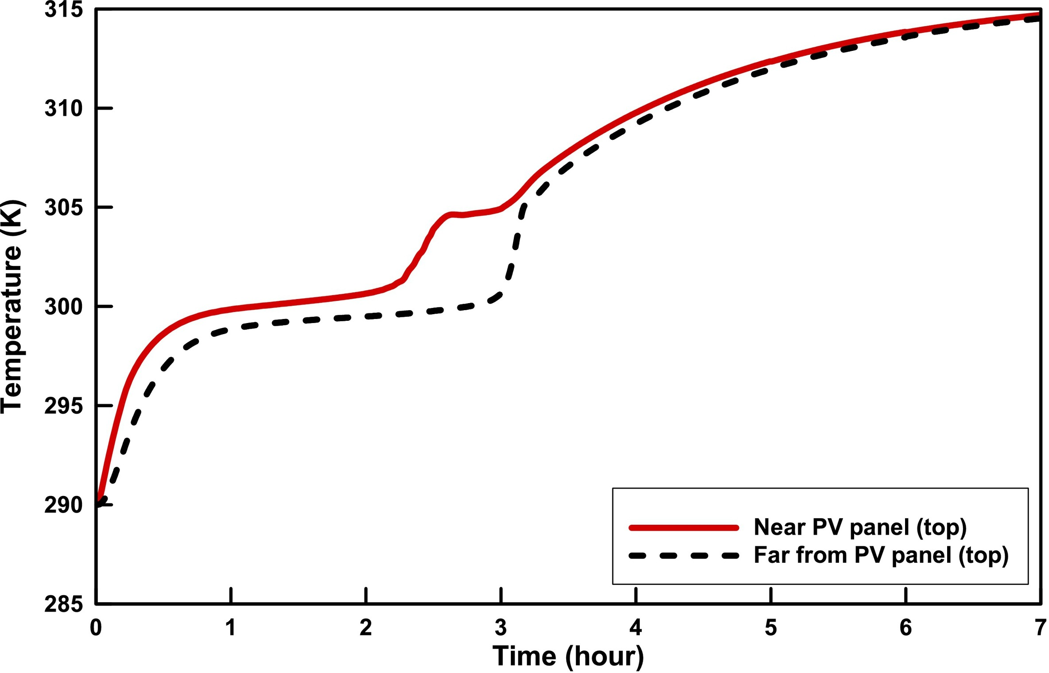
Results and discussion
The PCM temperatures at the top for distances of 13mm and 26mm from PV pannel

Slide 6
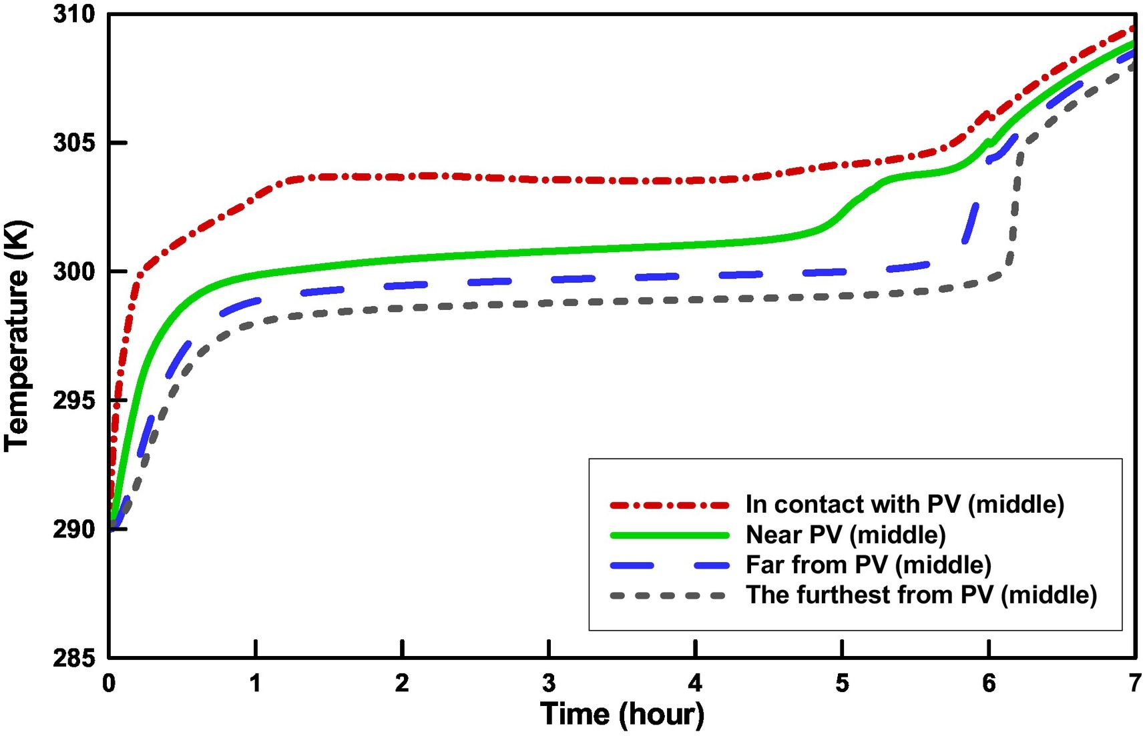
Result and Discussion
The PCM temperatures for different distances from the PV pannel

Slide 7
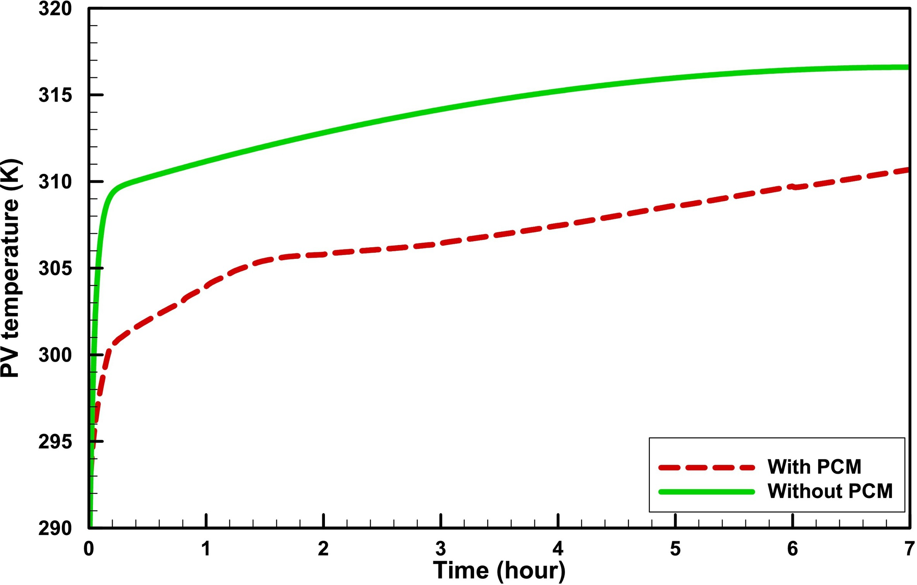
Results and Discussion
The temperature variation of PV panel with time

Slide 8
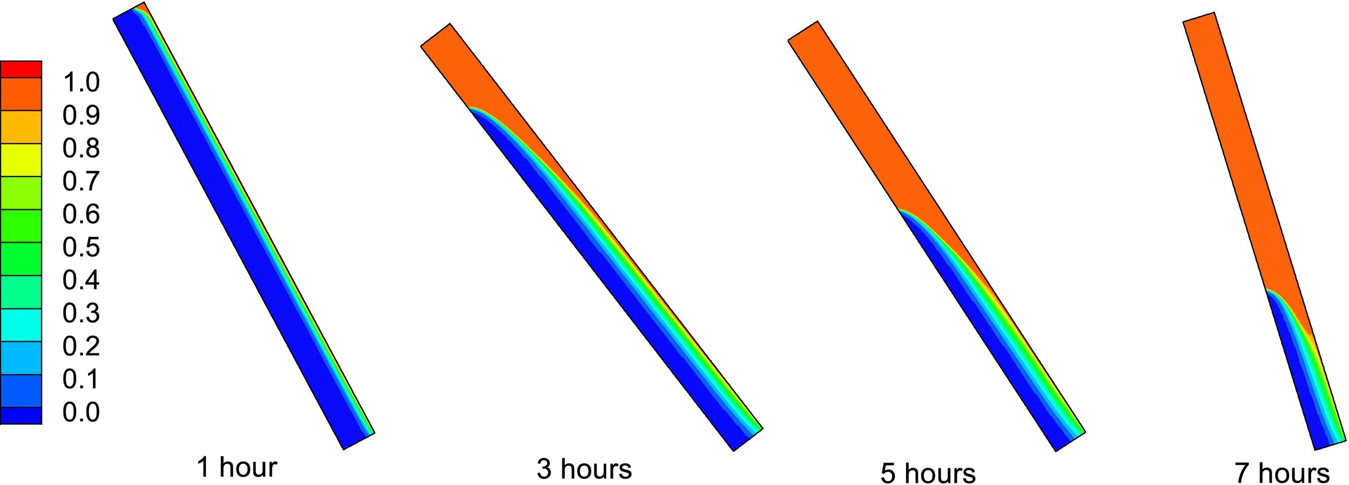
Liquid Fraction

Slide 9
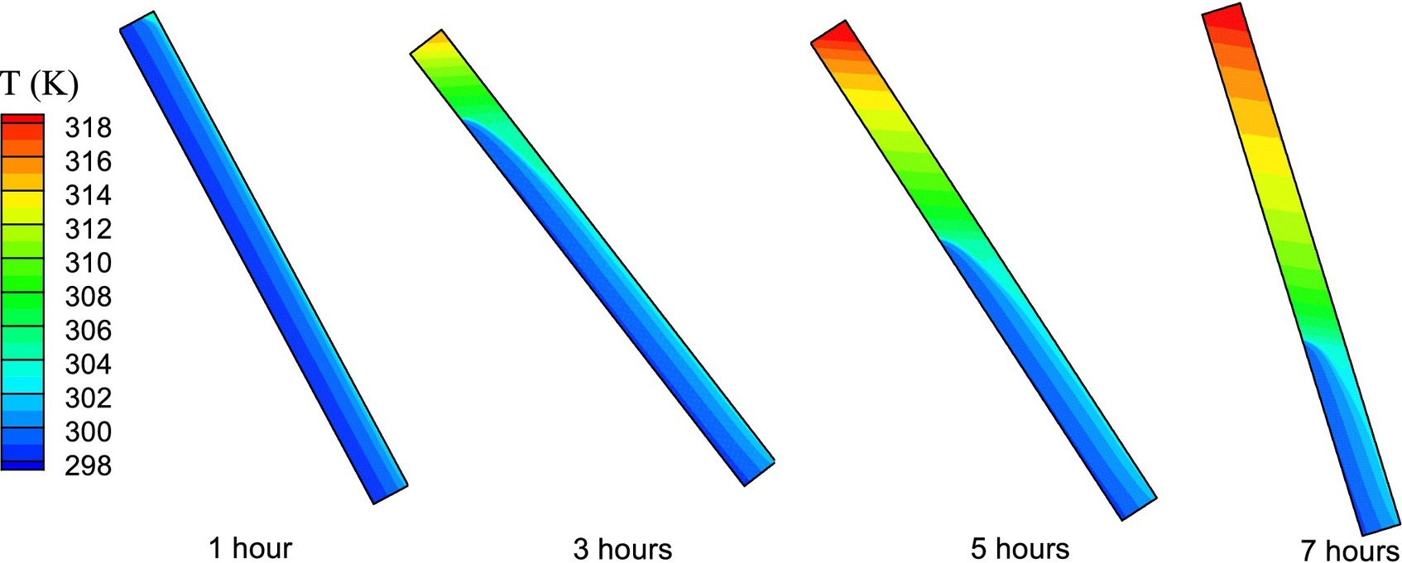
Temperature Distribution

Slide 10
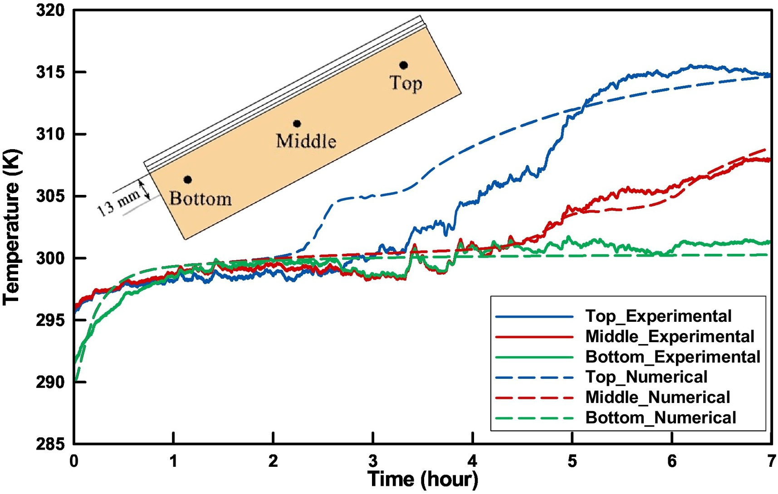
Experimental Validation

Slide 11

THANK YOU
19

